Slide 1
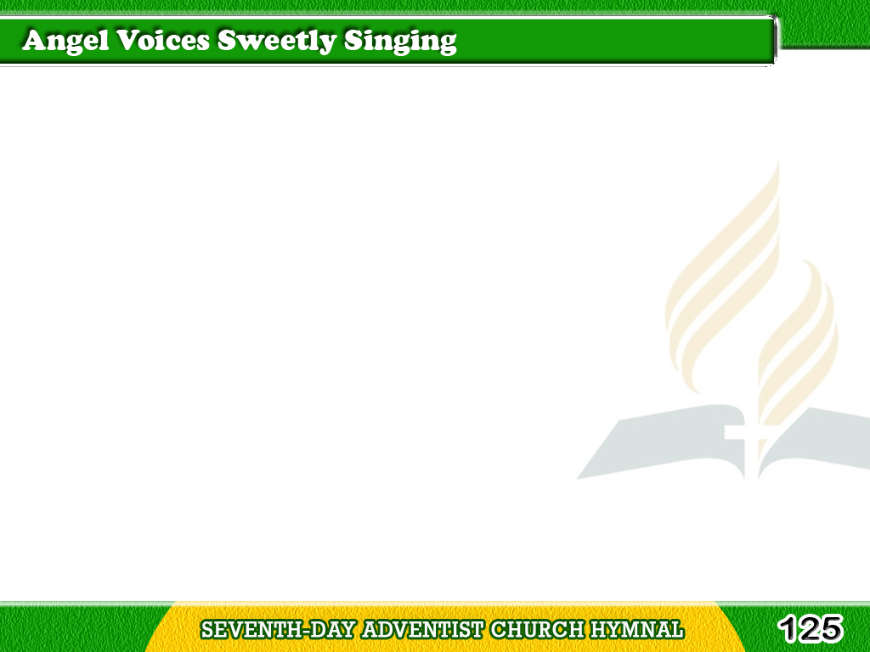
1/5
Angel voices sweetly singing,
Echoes through
the blue dome ringing,
Tagalog
Version

Slide 2
1/5
News of wondrous
gladness bringing;
Ah, ‘tis heaven at last!
Tagalog
Version

Slide 3
1/5
Chorus
Heaven at last,
heaven at last;
O, the joyful story
of heaven at last!
Tagalog
Version

Slide 4
1/5
Chorus
Heaven at last,
heaven at last;
Endless, boundless glory,
In heaven at last.
Tagalog
Version

Slide 5
2/5
On the jasper threshold standing,
Like a pilgrim safely landing,
See the strange
bright scene expanding;
Ah, ‘tis heaven at last!
Tagalog
Version

Slide 6
2/5
Chorus
Heaven at last,
heaven at last;
O, the joyful story
of heaven at last!
Tagalog
Version

Slide 7
2/5
Chorus
Heaven at last,
heaven at last;
Endless, boundless glory,
In heaven at last.
Tagalog
Version

Slide 8
3/5
Softest voices, silver pealing,
Freshest fragrance, spirit healing,
Happy hymns around us stealing,
Ah, ‘tis heaven at last!
Tagalog
Version

Slide 9
3/5
Chorus
Heaven at last,
heaven at last;
O, the joyful story
of heaven at last!
Tagalog
Version

Slide 10
3/5
Chorus
Heaven at last,
heaven at last;
Endless, boundless glory,
In heaven at last.
Tagalog
Version

Slide 11
4/5
Not a teardrops ever falleth,
Not a pleasure ever palleth,
Song to song forever calleth;
Ah, ‘tis heaven at last!
Tagalog
Version

Slide 12
4/5
Chorus
Heaven at last,
heaven at last;
O, the joyful story
of heaven at last!
Tagalog
Version

Slide 13
4/5
Chorus
Heaven at last,
heaven at last;
Endless, boundless glory,
In heaven at last.
Tagalog
Version

Slide 14
5/5
Christ Himself the living splendor,
Christ the sunlight,
mild and tender;
Praises to the Lamb we render;
Ah, ‘tis heaven at last!
Tagalog
Version

Slide 15
5/5
Chorus
Heaven at last,
heaven at last;
O, the joyful story
of heaven at last!
Tagalog
Version

Slide 16
5/5
Chorus
Heaven at last,
heaven at last;
Endless, boundless glory,
In heaven at last.
Tagalog
Version

